Slide 1
A Systematic Review: Consumers’ Electric Vehicles Adoption in developing countries from 2018 to 2022
Minyu Ye
2023/12/04
BADM504

Slide 2
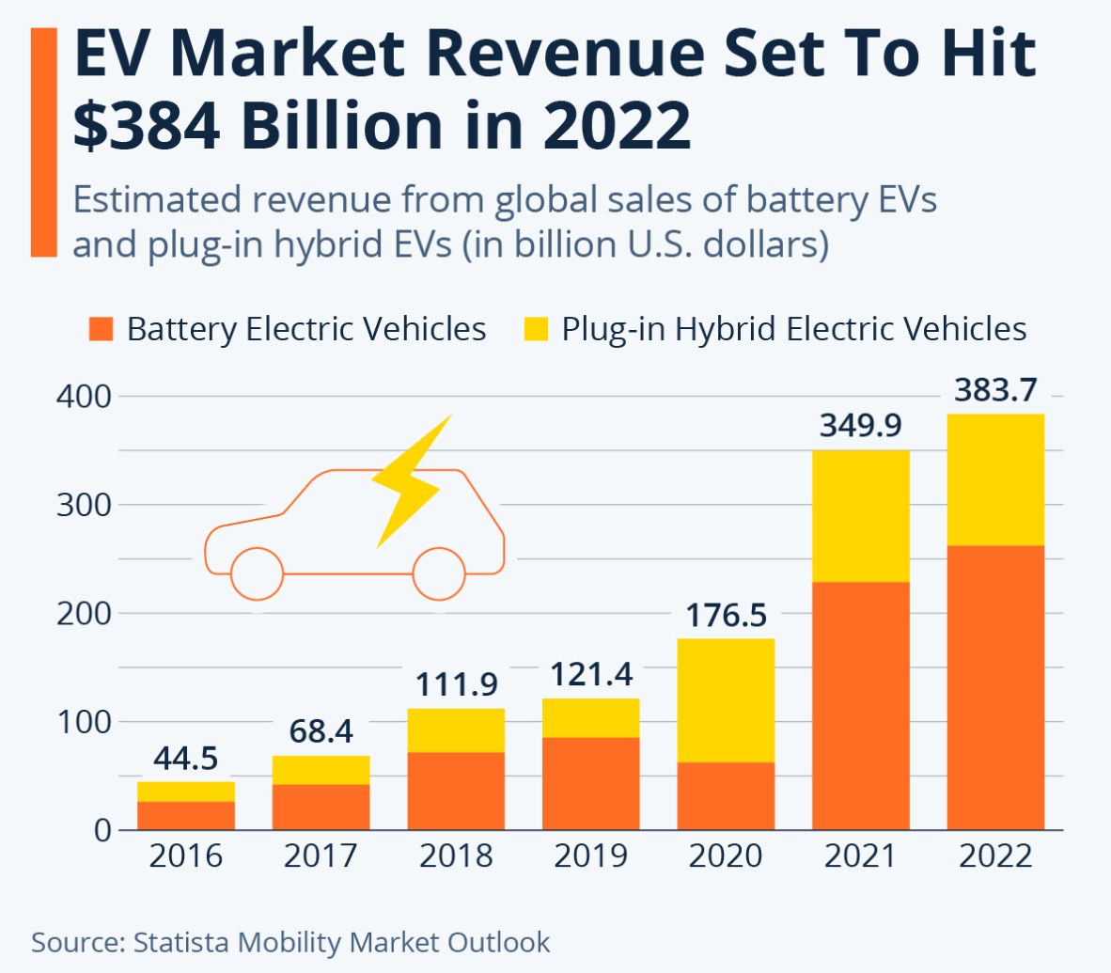
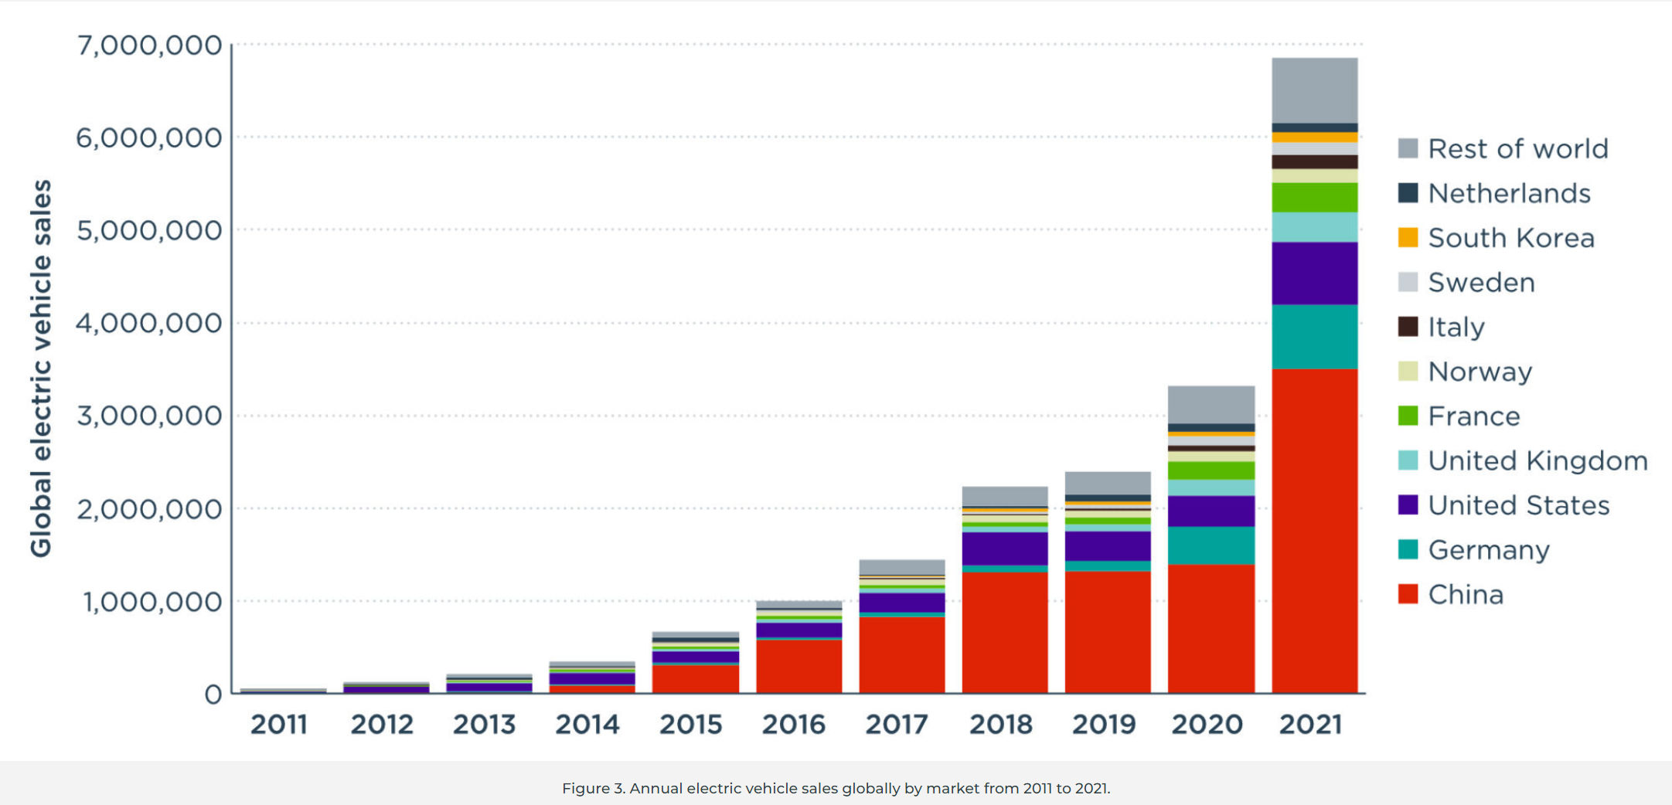
Introduction
Source: https://www.statista.com/chart/28211/electric-vehicles-revenue-projections/
https://theicct.org/publication/global-ev-update-2021-jun22/
BADM504

Slide 3
Research Question
The adoption of electric vehicles is a complex process influenced by a multitude of interconnected factors that span economic, social, technological, and environmental dimensions.
Understanding the dynamics of EV adoption in developing countries is particularly critical, given the unique challenges and opportunities most nations face.
The years 2018 to 2022 represent a period of rapid advancements in electric vehicle technology and a growing awareness of environmental issues.
What are the factors that influence consumers’ electric vehicle adoption in developing countries from 2018 to 2022?
BADM504

Slide 4
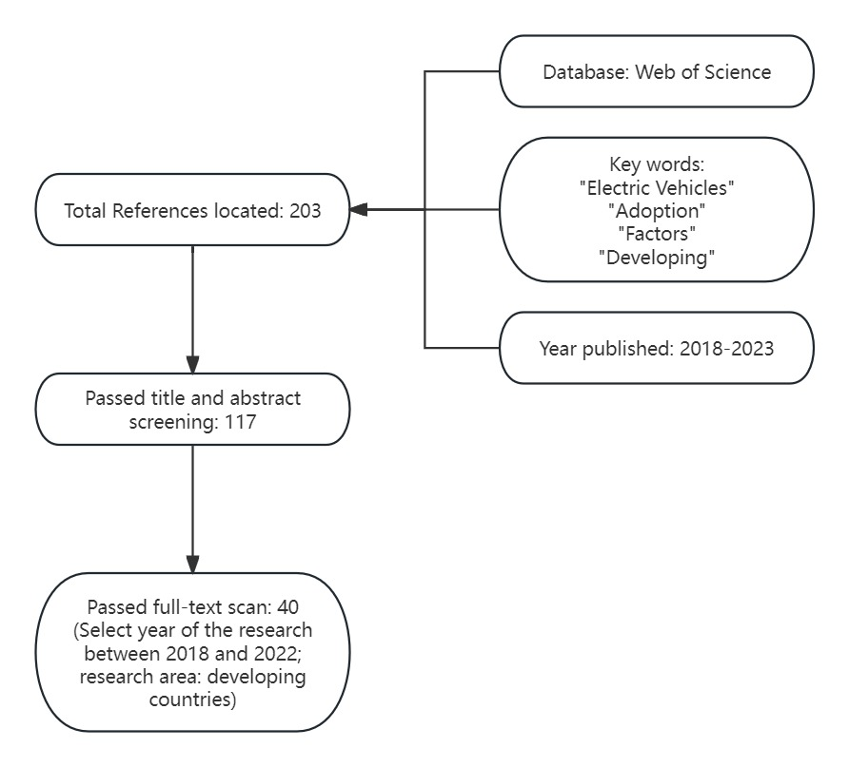
Method: Search Strategy
Fig. 1 Flow of references processed in the systematic review
BADM504

Slide 5
Study inclusion and data analysis
Table 1. Summary of Journal
Journal | Count of Article
SUSTAINABILITY | 11
TRANSPORTATION RESEARCH PART A-POLICY AND PRACTICE | 4
JOURNAL OF CLEANER PRODUCTION | 3
ENERGIES | 2
TRANSPORTATION RESEARCH PART D-TRANSPORT AND ENVIRONMENT | 2
INTERNATIONAL JOURNAL OF SUSTAINABLE TRANSPORTATION | 1
CASE STUDIES ON TRANSPORT POLICY | 1
JOURNAL OF DECISION SYSTEMS | 1
ENERGY POLICY | 1
TRANSPORTATION IN DEVELOPING ECONOMIES | 1
ENVIRONMENTAL SCIENCE AND POLLUTION RESEARCH | 1
CURRENT PSYCHOLOGY | 1
EUROPEAN JOURNAL OF TRANSPORT AND INFRASTRUCTURE RESEARCH | 1
RESEARCH IN TRANSPORTATION BUSINESS AND MANAGEMENT | 1
TRANSPORTATION LETTERS-THE INTERNATIONAL JOURNAL OF TRANSPORTATION RESEARCH | 1
TRANSPORT POLICY | 1
COGENT BUSINESS & MANAGEMENT | 1
COGENT ENGINEERING | 1
BUSINESS STRATEGY AND DEVELOPMENT | 1
INDUSTRIAL MANAGEMENT & DATA SYSTEMS | 1
WORLD ELECTRIC VEHICLE JOURNAL | 1
INNOVATIVE MARKETING | 1
INTERNATIONAL JOURNAL OF NONPROFIT AND VOLUNTARY SECTOR MARKETING | 1
Total | 40
Fig. 2 Top 5 Journals

Slide 6
Study inclusion and data analysis
Fig. 3 Research year of articles in the systematic review
BADM504

Slide 7
Nature of the theory, methodology and factors
Table 3. Summary of Methodology
Table 2. Summary of Theory
Methodology
Correlation analysis
Regression analysis
A dual-factor model
A multivariate statistical procedure
Semi-structured interviews
Extended Technology Acceptance Model (TAM)
Binary probit and ordered probit model
Configurational perspective and the fsQCA (fuzzy-set qualitative comparative analysis) approach
Factor analysis
Machine learning techniques
Maximum Likelihood Estimation method
Path analysis
Multinomial Logit (MNL) models and Moran’s I for spatial analysis
Partial least squares (PLS) method
Partial Least Squares Structural Equation Modeling (PLS-SEM)
Principal Component Analysis (PCA)
Structural equation model (SEM)
Confirmatory factor analysis (CFA)
Theory
Theory of Planned Behavior (TPB)
Social network theory
Innovation Diffusion Theory (IDT)
Environmental concern theory
Decomposed Theory of Planned Behavior (DTPB)
Theory of Exploratory Factor Analysis (EFA)
Theory of Necessary Conditions Analysis (NCA)
Status Quo Bias(SQB) theory
Value-belief-norm (VBN) theory
Extended Theory of Planned Behavior (ETPB)
Norm Activation Model (NAM)
Theory of Reasoned Action (TRA)
Unified Theory of Acceptance and Use of Technology (UTAUT)
BADM504

Slide 8
Nature of the theory, methodology and factors
Table 4. Geographic distribution of research
Country/City | Count of Article
China | 20
India | 10
Thailand | 1
Pakistan | 1
Malaysia | 1
Ghana | 1
Poland | 1
Turkey | 1
Brazil | 1
Vietnam | 1
Bahrain | 1
Indonesia | 1
Total | 40
Fig. 4 Country/City covered
BADM504

Slide 9
Result: Systematic Review
Category | Details
Behavior | Perceived value: This factor refers to the perceived benefits and advantages of using electric vehicles, such as cost savings, environmental friendliness, and technological advancements. Attitude: The attitude of consumers towards electric vehicles, including their personal preferences, beliefs, and opinions about EVs, can influence their intention to adopt them. Ascription of responsibility: This factor relates to consumers’ perception of their responsibility towards the environment and their willingness to contribute to sustainability by adopting electric vehicles. Subjective norms: Subjective norms refer to the influence of social factors, such as family, friends, and society, on consumers’ intention to adopt electric vehicles. It includes the perceived social pressure and approval/disapproval from others. Personal norms: Personal norms are the internalized beliefs and values of individuals regarding environmental responsibility and sustainability. These norms can influence consumers’ intention to adopt electric vehicles. Perceived consumer effectiveness: This factor relates to consumers’ belief in their ability to make a positive impact on the environment by adopting electric vehicles. It includes their confidence in using EVs and their perception of their own effectiveness in reducing carbon emissions. Awareness of consequences: Consumers’ awareness of the environmental consequences of using conventional vehicles versus electric vehicles can influence their intention to adopt EVs. This includes knowledge about the environmental benefits and impacts of EVs.
BADM504

Slide 10
Result: Systematic Review
Category | Details
Economics | Price: The price of EVs compared to traditional cars is a significant factor influencing adoption intentions. Government Policies: Incentives such as subsidies, tax benefits, and infrastructure development initiatives can positively impact the adoption of EVs. Financial motivations: Factors such as purchase price, fuel cost, maintenance cost, and overall cost are important determinants of people’s preference for EVs.
Infrastructure | Availability of charging facility: The accessibility and availability of charging infrastructure for EVs.
BADM504

Slide 11
Result: Systematic Review
Category | Details
Technical features | Vehicle performance barriers: Consumers are concerned about the maximum range offered by EVs in a single charge and the lengthy charging times. Range anxiety, or the fear of running out of charge during long journeys, is a significant factor. The lengthy charging time and the inconvenience of recharging facilities at home and along highways also contribute to the performance barriers. Technological factors: These include driving range, charging time, noise, acceleration, CO2 emissions, functionality, reliability, safety, and image of EVs.
Individual features | Societal influence: The influence of peers, family, and society plays a role in consumers’ consideration of the environment when purchasing an EV. Social responsibility and the opinions of people close to them influence their decision. Age: Younger age groups are more interested in adopting EVs compared to older age groups. Mode of transportation: Personal car users were found to have lower intentions to adopt EVs compared to users of other modes of transportation, such as public transport and pedestrians. Socio-demographic factors: Socio-demographic factors such as income and employment status were found to influence EV preferences. For example, part-time workers and high-income individuals were more likely to support BEVs, while individuals living in apartments were more likely to support FCEVs.
BADM504

Slide 12
Conclusion
This review provided an examination of the factors influencing consumers’ electric vehicle (EV) adoption in developing countries from 2018 to 2022.
The intricate interplay of behavioral, economic, infrastructural, technical, and individual features shapes the decision-making process of consumers in adopting electric vehicles.
Policymakers, industry stakeholders, and researchers can collaborate to formulate comprehensive strategies that address the nuanced interplay of different factors.
BADM504

Slide 13
References
Asadi, S., Nilashi, M., Samad, S., Abdullah, R., Mahmoud, M., Alkinani, M. H., & Yadegaridehkordi, E. (2021). Factors impacting consumers’ intention toward adoption of electric vehicles in Malaysia. Journal of Cleaner Production, 282, 124474. https://doi.org/10.1016/j.jclepro.2020.124474
Ackaah, W., Kanton, A. T., & Osei, K. K. (2021). Factors influencing consumers’ intentions to purchase electric vehicles in Ghana. Transportation Letters, 14(9), 1031–1042. https://doi.org/10.1080/19427867.2021.1990828
Krishnan, V. V., & Koshy, B. I. (2021). Evaluating the factors influencing purchase intention of electric vehicles in households owning conventional vehicles. Case Studies on Transport Policy, 9(3), 1122–1129. https://doi.org/10.1016/j.cstp.2021.05.013
Dong, X., Zhang, B., Wang, B., & Wang, Z. (2020). Urban households’ purchase intentions for pure electric vehicles under subsidy contexts in China: Do cost factors matter? Transportation Research Part A: Policy and Practice, 135, 183–197. https://doi.org/10.1016/j.tra.2020.03.012
Jayasingh, S., Girija, T., & Arunkumar, S. (2021). Factors influencing consumers’ purchase intention towards electric two-wheelers. Sustainability, 13(22), 12851. https://doi.org/10.3390/su132212851
Huang, X., & Ge, J. (2019). Electric Vehicle Development in Beijing: An analysis of consumer purchase intention. Journal of Cleaner Production, 216, 361–372. https://doi.org/10.1016/j.jclepro.2019.01.231
Zhang, J., Xu, S., He, Z., Li, C., & Meng, X. (2022). Factors influencing adoption intention for electric vehicles under a subsidy deduction: From different city-level perspectives. Sustainability, 14(10), 5777. https://doi.org/10.3390/su14105777
Joshi, N., Malhotra, M., & Singh, J. (2022). Assessing adoption intention of electric vehicles in India: The mediating role of government policies. European Journal of Transport and Infrastructure Research, 22(1). https://doi.org/10.18757/ejtir.2022.22.1.5973
Jiang, Q., Wei, W., Guan, X., & Yang, D. (2021). What increases consumers’ purchase intention of battery electric vehicles from Chinese electric vehicle start-ups? taking Nio as an example. World Electric Vehicle Journal, 12(2), 71. https://doi.org/10.3390/wevj12020071
Ye, F., Kang, W., Li, L., & Wang, Z. (2021). Why do consumers choose to buy electric vehicles? A paired data analysis of purchase intention configurations. Transportation Research Part A: Policy and Practice, 147, 14–27. https://doi.org/10.1016/j.tra.2021.02.014
He, Z., Zhou, Y., Wang, J., Shen, W., Li, W., & Lu, W. (2022). Influence of emotion on purchase intention of electric vehicles: A Comparative Study of consumers with different income levels. Current Psychology, 42(25), 21704–21719. https://doi.org/10.1007/s12144-022-03253-1
Wei, W., Cao, M., Jiang, Q., Ou, S.-J., & Zou, H. (2020). What influences Chinese consumers’ adoption of battery electric vehicles? A preliminary study based on factor analysis. Energies, 13(5), 1057. https://doi.org/10.3390/en13051057
Gunawan, I., Redi, A. A., Santosa, A. A., Maghfiroh, M. F., Pandyaswargo, A. H., & Kurniawan, A. C. (2022). Determinants of customer intentions to use electric vehicle in Indonesia: An integrated model analysis. Sustainability, 14(4), 1972. https://doi.org/10.3390/su14041972
BADM504

Slide 14
References
Wang, X.-W., Cao, Y.-M., & Zhang, N. (2021). The influences of incentive policy perceptions and consumer social attributes on Battery Electric Vehicle Purchase Intentions. Energy Policy, 151, 112163. https://doi.org/10.1016/j.enpol.2021.112163
Lee, J., Baig, F., Talpur, M. A., & Shaikh, S. (2021). Public intentions to purchase electric vehicles in Pakistan. Sustainability, 13(10), 5523. https://doi.org/10.3390/su13105523
Yeğin, T., & Ikram, M. (2022). Analysis of consumers’ Electric Vehicle Purchase Intentions: An expansion of the theory of planned behavior. Sustainability, 14(19), 12091. https://doi.org/10.3390/su141912091
Liao, Y. (2021). Intention of consumers to adopt electric vehicle in the post-subsidy era: Evidence from China. International Journal of Sustainable Transportation, 16(7), 647–659. https://doi.org/10.1080/15568318.2021.1918297
Sun, K. K., He, S. Y., & Thøgersen, J. (2022). The purchase intention of electric vehicles in Hong Kong, a high-density Asian context, and main differences from a Nordic context. Transport Policy, 128, 98–112. https://doi.org/10.1016/j.tranpol.2022.09.009
K V, S., Michael, L. K., Hungund, S. S., & Fernandes, M. (2022). Factors influencing adoption of electric vehicles - a case in India. Cogent Engineering, 9(1). https://doi.org/10.1080/23311916.2022.2085375
Yang, C., Tu, J.-C., & Jiang, Q. (2020). The influential factors of consumers’ sustainable consumption: A case on electric vehicles in China. Sustainability, 12(8), 3496. https://doi.org/10.3390/su12083496
Hoang, T. T., Pham, T. H., & Vu, T. M. (2022). Examining customer purchase decision towards battery electric vehicles in Vietnam market: A combination of self-interested and pro-environmental approach. Cogent Business &amp; Management, 9(1). https://doi.org/10.1080/23311975.2022.2141671
Dutta, B., & Hwang, H.-G. (2021). Consumers purchase intentions of Green Electric Vehicles: The influence of consumers technological and environmental considerations. Sustainability, 13(21), 12025. https://doi.org/10.3390/su132112025
Zheng, S., Liu, H., Guan, W., Yang, Y., Li, J., Fahad, S., & Li, B. (2022). Identifying intention-based factors influencing consumers’ willingness to pay for electric vehicles: A sustainable consumption paradigm. Sustainability, 14(24), 16831. https://doi.org/10.3390/su142416831
Sovacool, B. K., Abrahamse, W., Zhang, L., & Ren, J. (2019). Pleasure or profit? surveying the purchasing intentions of potential electric vehicle adopters in China. Transportation Research Part A: Policy and Practice, 124, 69–81. https://doi.org/10.1016/j.tra.2019.03.002
Manutworakit, P., & Choocharukul, K. (2022). Factors influencing battery electric vehicle adoption in Thailand—expanding the unified theory of acceptance and use of technology’s variables. Sustainability, 14(14), 8482. https://doi.org/10.3390/su14148482
Buranelli de Oliveira, M., Moretti Ribeiro da Silva, H., Jugend, D., De Camargo Fiorini, P., & Paro, C. E. (2022). Factors influencing the intention to use electric cars in Brazil. Transportation Research Part A: Policy and Practice, 155, 418–433. https://doi.org/10.1016/j.tra.2021.11.018
Zhuge, C., & Shao, C. (2019). Investigating the factors influencing the uptake of electric vehicles in Beijing, China: Statistical and spatial perspectives. Journal of Cleaner Production, 213, 199–216. https://doi.org/10.1016/j.jclepro.2018.12.099
BADM504

Slide 15
References
Tu, J.-C., & Yang, C. (2019). Key factors influencing consumers’ purchase of Electric Vehicles. Sustainability, 11(14), 3863. https://doi.org/10.3390/su11143863
Huang, X., Lin, Y., Lim, M. K., Tseng, M.-L., & Zhou, F. (2021). The influence of knowledge management on adoption intention of electric vehicles: Perspective on Technological Knowledge. Industrial Management &amp; Data Systems, 121(7), 1481–1495. https://doi.org/10.1108/imds-07-2020-0411
Verma, M., Verma, A., & Khan, M. (2020). Factors influencing the adoption of electric vehicles in Bengaluru. Transportation in Developing Economies, 6(2). https://doi.org/10.1007/s40890-020-0100-x
Jain, N. K., Bhaskar, K., & Jain, S. (2022). What drives adoption intention of electric vehicles in India? an integrated utaut model with environmental concerns, perceived risk and government support. Research in Transportation Business &amp; Management, 42, 100730. https://doi.org/10.1016/j.rtbm.2021.100730
Sobiech-Grabka, K., Stankowska, A., & Jerzak, K. (2022). Determinants of electric cars purchase intention in Poland: Personal attitudes v. economic arguments. Energies, 15(9), 3078. https://doi.org/10.3390/en15093078
Li, L., Wang, Z., & Wang, Q. (2020). Do policy mix characteristics matter for electric vehicle adoption? A survey-based exploration. Transportation Research Part D: Transport and Environment, 87, 102488. https://doi.org/10.1016/j.trd.2020.102488
Chaudhary, P., & Kate, N. (2023). The coalescence effect: Understanding the impact of customer value proposition, perceived benefits and climate change sensitivities on electric vehicle adoption in India. Business Strategy &amp; Development. https://doi.org/10.1002/bsd2.282
Chhikara, R., Garg, R., Chhabra, S., Karnatak, U., & Agrawal, G. (2021). Factors affecting adoption of electric vehicles in India: An exploratory study. Transportation Research Part D: Transport and Environment, 100, 103084. https://doi.org/10.1016/j.trd.2021.103084
Ali, I., & Naushad, M. (2022). Insights on electric vehicle adoption: Does attitude play a mediating role? Innovative Marketing, 18(1), 104–116. https://doi.org/10.21511/im.18(1).2022.09
Shankar, A., & Kumari, P. (2019). Exploring the enablers and inhibitors of electric vehicle adoption intention from sellers’ perspective in India: A view of the dual‐factor model. International Journal of Nonprofit and Voluntary Sector Marketing, 24(4). https://doi.org/10.1002/nvsm.1662
Liu, R., Ding, Z., Jiang, X., Sun, J., Jiang, Y., & Qiang, W. (2020). How does experience impact the adoption willingness of battery electric vehicles? the role of psychological factors. Environmental Science and Pollution Research, 27(20), 25230–25247. https://doi.org/10.1007/s11356-020-08834-w
Shareeda, A., Al-Hashimi, M., & Hamdan, A. (2021). Smart Cities and Electric Vehicles Adoption in Bahrain. Journal of Decision Systems, 30(2–3), 321–343. https://doi.org/10.1080/12460125.2021.1911024
Xia, Z., Wu, D., & Zhang, L. (2022). Economic, functional, and social factors influencing electric vehicles’ adoption: An empirical study based on the diffusion of innovation theory. Sustainability, 14(10), 6283. https://doi.org/10.3390/su14106283
BADM504

Slide 16
Thank you!

